Slide 1


Team Introduction
Before diving into the details of VibeSync, let's meet the talented team behind the social media application, each bringing unique skills and expertise to the table to create an exceptional social media website.
Vanshika - 2110991959
Shivaksh Sharma - 2110992079
Sakhib Ali - 2110992002
Anant Sharma - 2110991978
Hritik Mishra - 2110991960

Slide 2

Introduction to VibeSync
1
Connect and Share
2
Personalized Experience
3
Expressive Profiles
VibeSync is a social media platform that allows users to connect and share their interests, passions, and experiences with like-minded individuals in a vibrant and dynamic community.
Experience tailored content and exciting conversations based on your interests and preferences, making each interaction on VibeSync unique and engaging.
Users can create expressive profiles that truly reflect their personality and interests, fostering meaningful connections with others who share similar vibes.

Slide 3
Features of VibeSync
Community Engagement
Customizable Feeds
Engage with vibrant communities, join discussions, and participate in events centered around your interests.
Personalize your feed to see the content that resonates with you, ensuring an enriching and tailored social media experience.
Content Sharing
Interactive Polls
Share articles, posts, images, and videos with your followers, igniting conversations and sparking creativity.
Create and participate in interactive polls and surveys, gathering insights and fostering engagement within the community.

Slide 4




Benefits of using VibeSync
Unique Interactions
Experience vibrant and meaningful interactions with a diverse community of like-minded individuals.
Personalized Content
Enjoy curated content tailored to your interests, sparking inspiration and driving engagement.
Community Empowerment
Empower yourself and others by sharing knowledge, experiences, and fostering a positive and inclusive online environment.

Slide 5
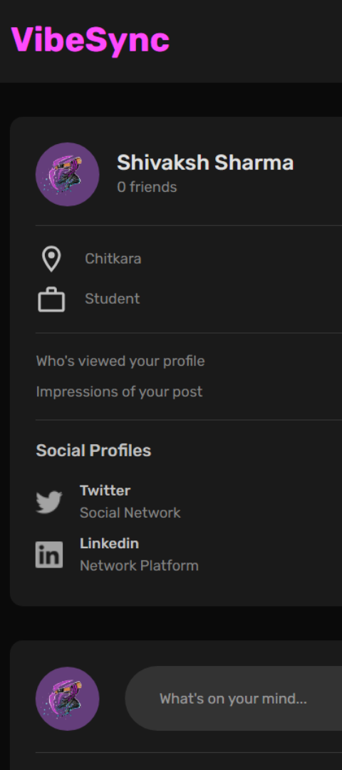
Demo of the App's Interface
User-Friendly Design
Interactive Features
Explore an intuitive and visually appealing app interface designed for seamless navigation and efficient interactions.
Engage with various interactive features that encourage participation and facilitate vibrant conversations.
Engaging Visuals
Immerse yourself in stunning visuals and captivating content, creating a delightful user experience.

Slide 6
Technologies Used
Node.js
ReactJs
Powerful Backend
Interactive Frontend
Utilizing the robust capabilities of Node.js for a stable and efficient backend infrastructure.
Creating an engaging and responsive frontend experience using the power of ReactJs.
MongoDB
Express.js
Scalable Database
Efficient Routing
Leveraging MongoDB's scalability and flexibility to handle diverse user data and content.
Streamlining server-side processes with the efficiency of Express.js routing and middleware capabilities.

Slide 7
Key Components
HTML5 and CSS3: Semantic Elements, CSS Grid, Flexbox
React: Components, Props, Events, Hooks, Router, Axios
Context API: Store, Reducers, Actions
Node & Express: Web API, Body Parser, File Upload, JWT
MongoDB: Mongoose, Aggregation
Development: ESLint, Babel, Git, Github,
Deployment: Heroku

Slide 8
ReactJs
Our frontend, powered by ReactJS, ensures a dynamic and responsive interface that captivates users from the moment they land on our site. Immerse yourself in a visually stunning and intuitively designed environment, crafted to enhance social connections and user engagement. With ReactJS, we bring you a fast, interactive, and user-friendly interface that adapts seamlessly to various devices, providing an unparalleled experience for users to connect, share, and explore the endless possibilities of our thriving online community.

Slide 9
NodeJs
Powering the backbone of our social media platform is the robust and scalable Node.js backend. Seamlessly handling data, authentication, and real-time interactions, Node.js ensures that our website delivers a swift and efficient user experience. Leveraging the event-driven, non-blocking architecture of Node.js, we achieve high performance and responsiveness, crucial for a dynamic social environment. With Node.js, we have created a backend that effortlessly scales to meet the demands of our growing community, providing a reliable foundation for secure data management, real-time updates, and a seamless integration of features. Embrace the agility and efficiency of Node.js as we pave the way for a social media experience that's not just connected, but also powered by cutting-edge technology.

Slide 10
MongoDB
MongoDB, a robust and flexible NoSQL database that empowers us to manage and organize vast amounts of data with unparalleled efficiency. MongoDB's document-oriented architecture seamlessly integrates with our dynamic content, providing a scalable and high-performance solution for storing and retrieving user information, posts, and interactions. With MongoDB, we ensure data integrity, flexibility, and the ability to scale horizontally as our social community continues to grow. Experience a backend that not only handles the complexities of social interactions but also adapts effortlessly to the evolving needs of our dynamic online ecosystem.

Slide 11

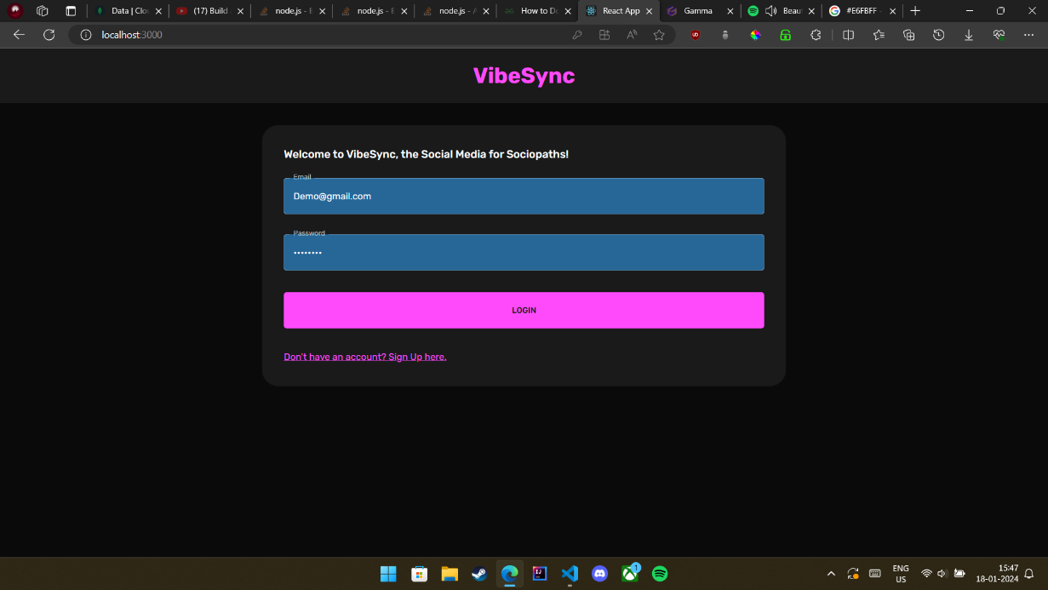

Slide 12
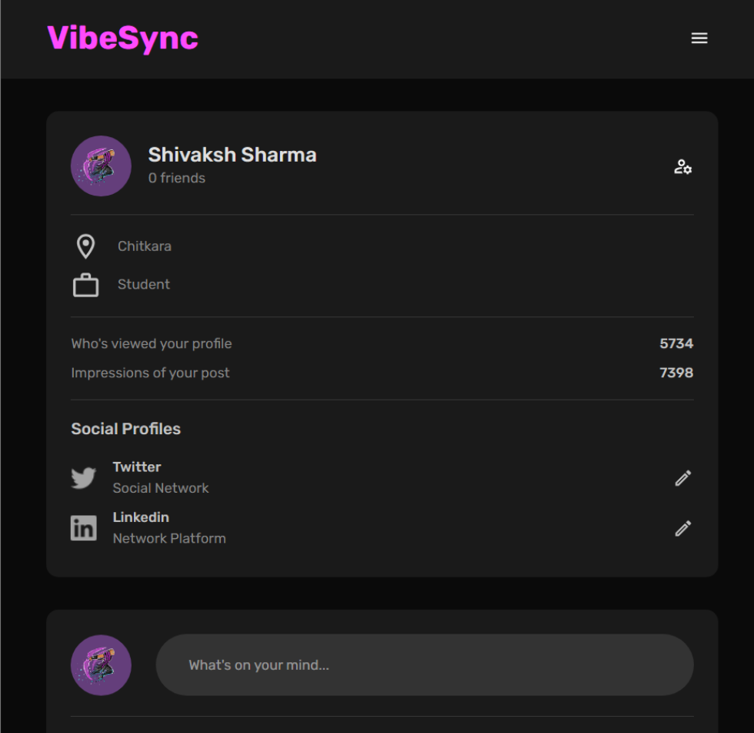

Slide 13

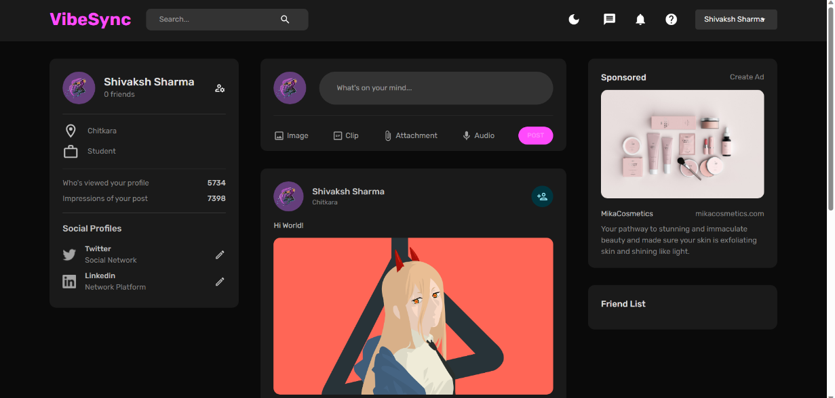

Slide 14
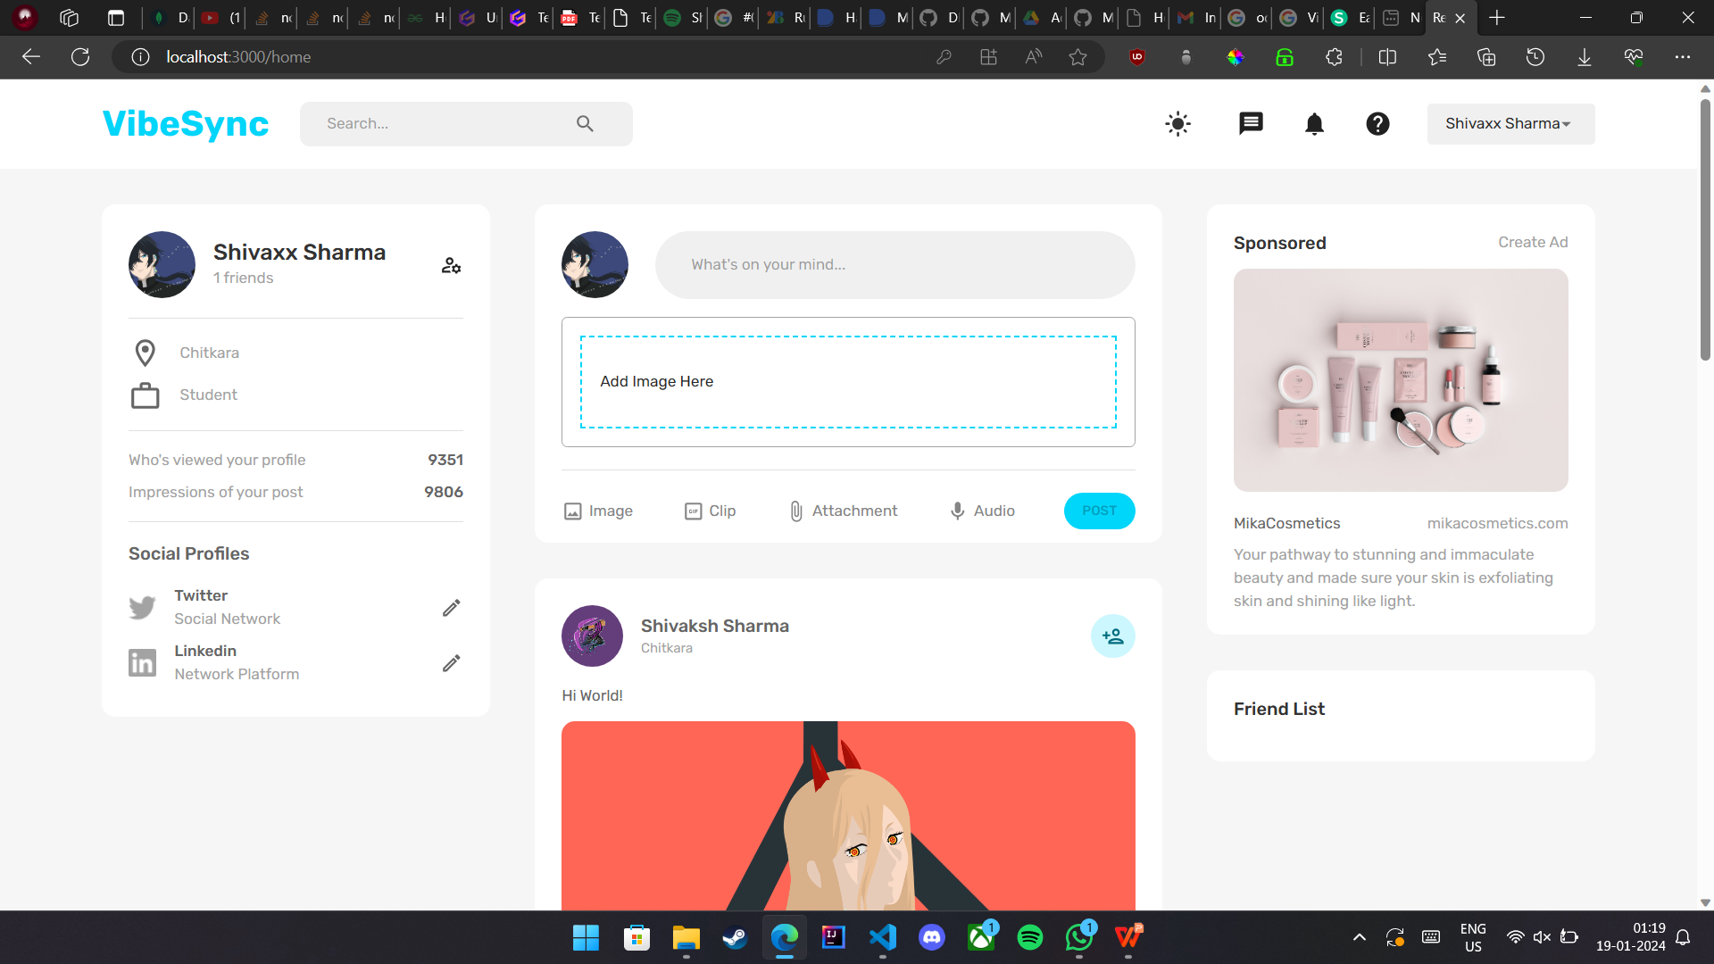

Slide 15
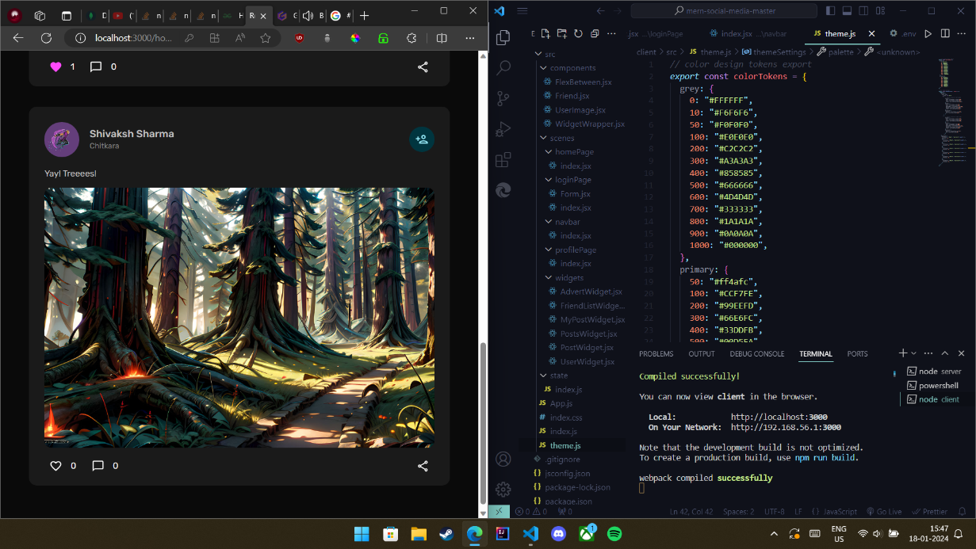

Slide 16
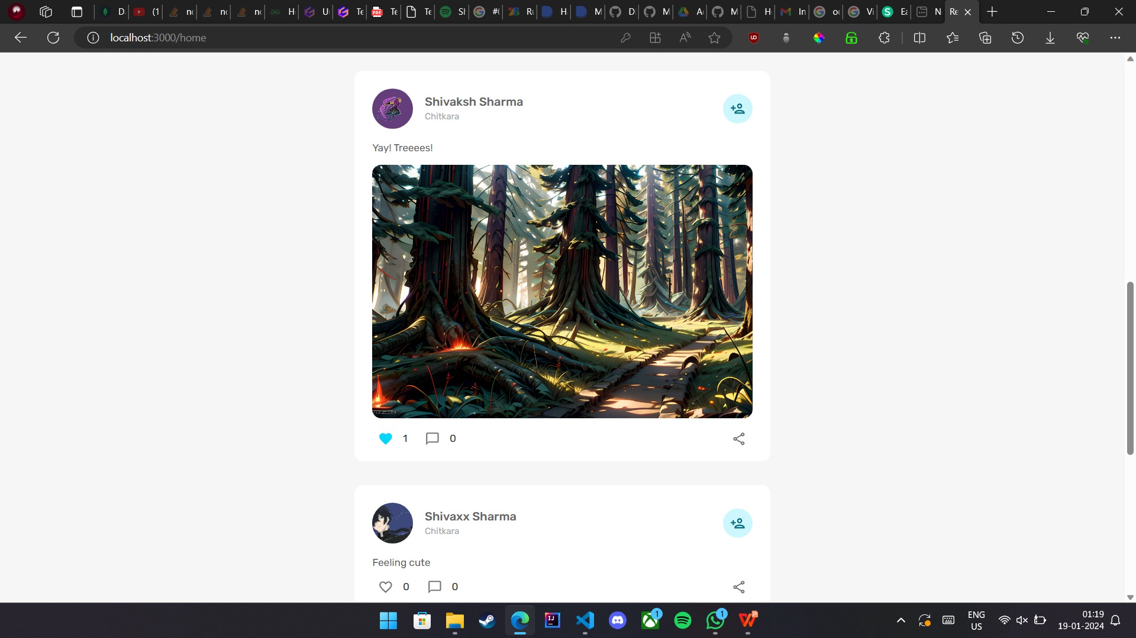

Slide 17

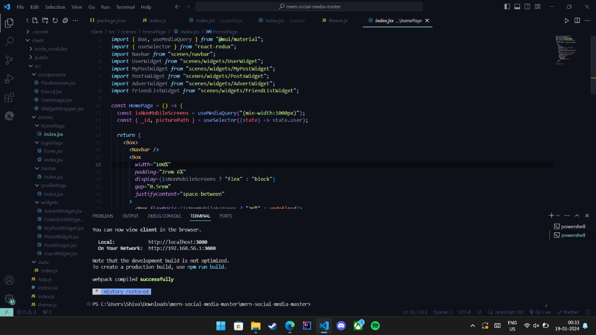

Slide 18
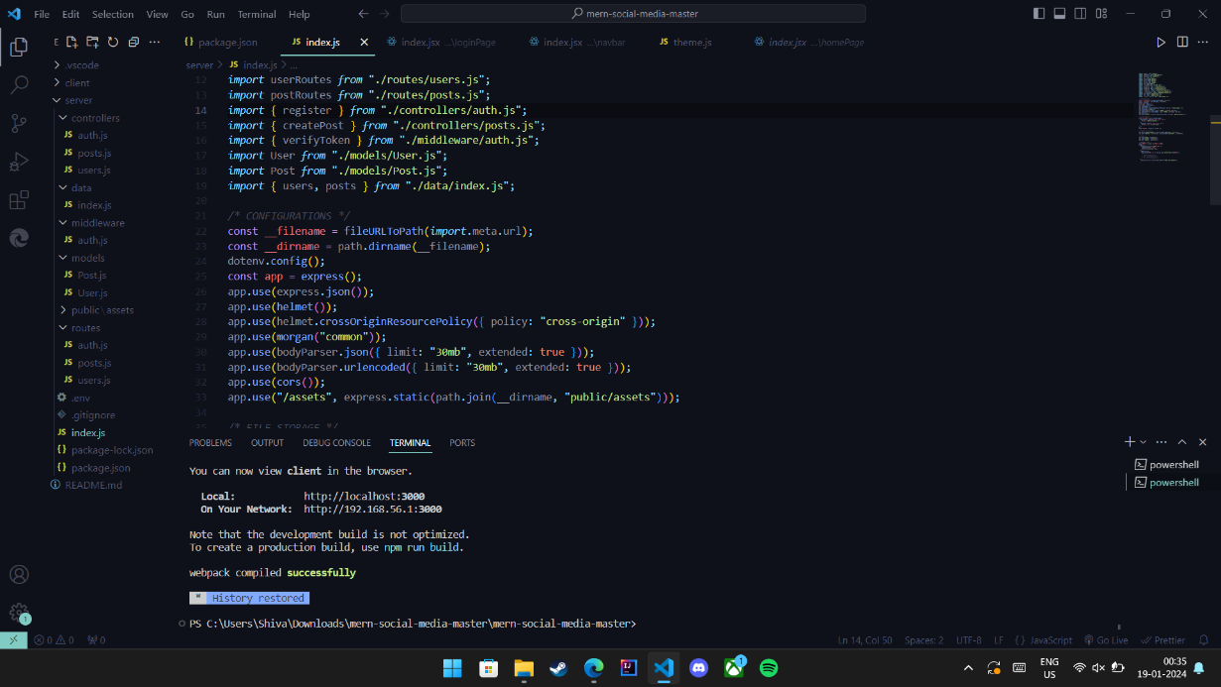


Slide 19
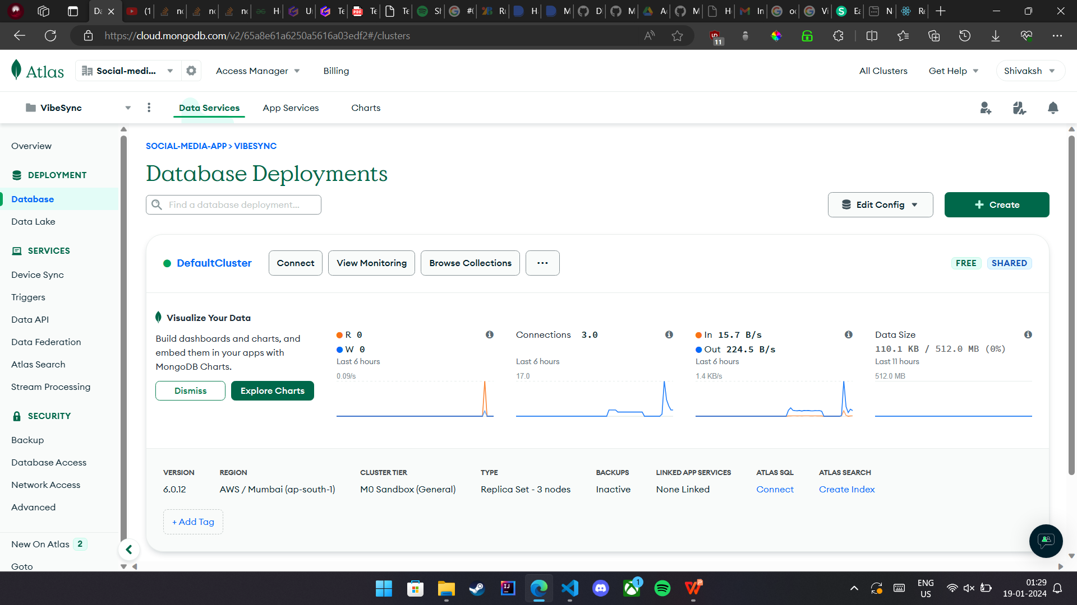

Slide 20
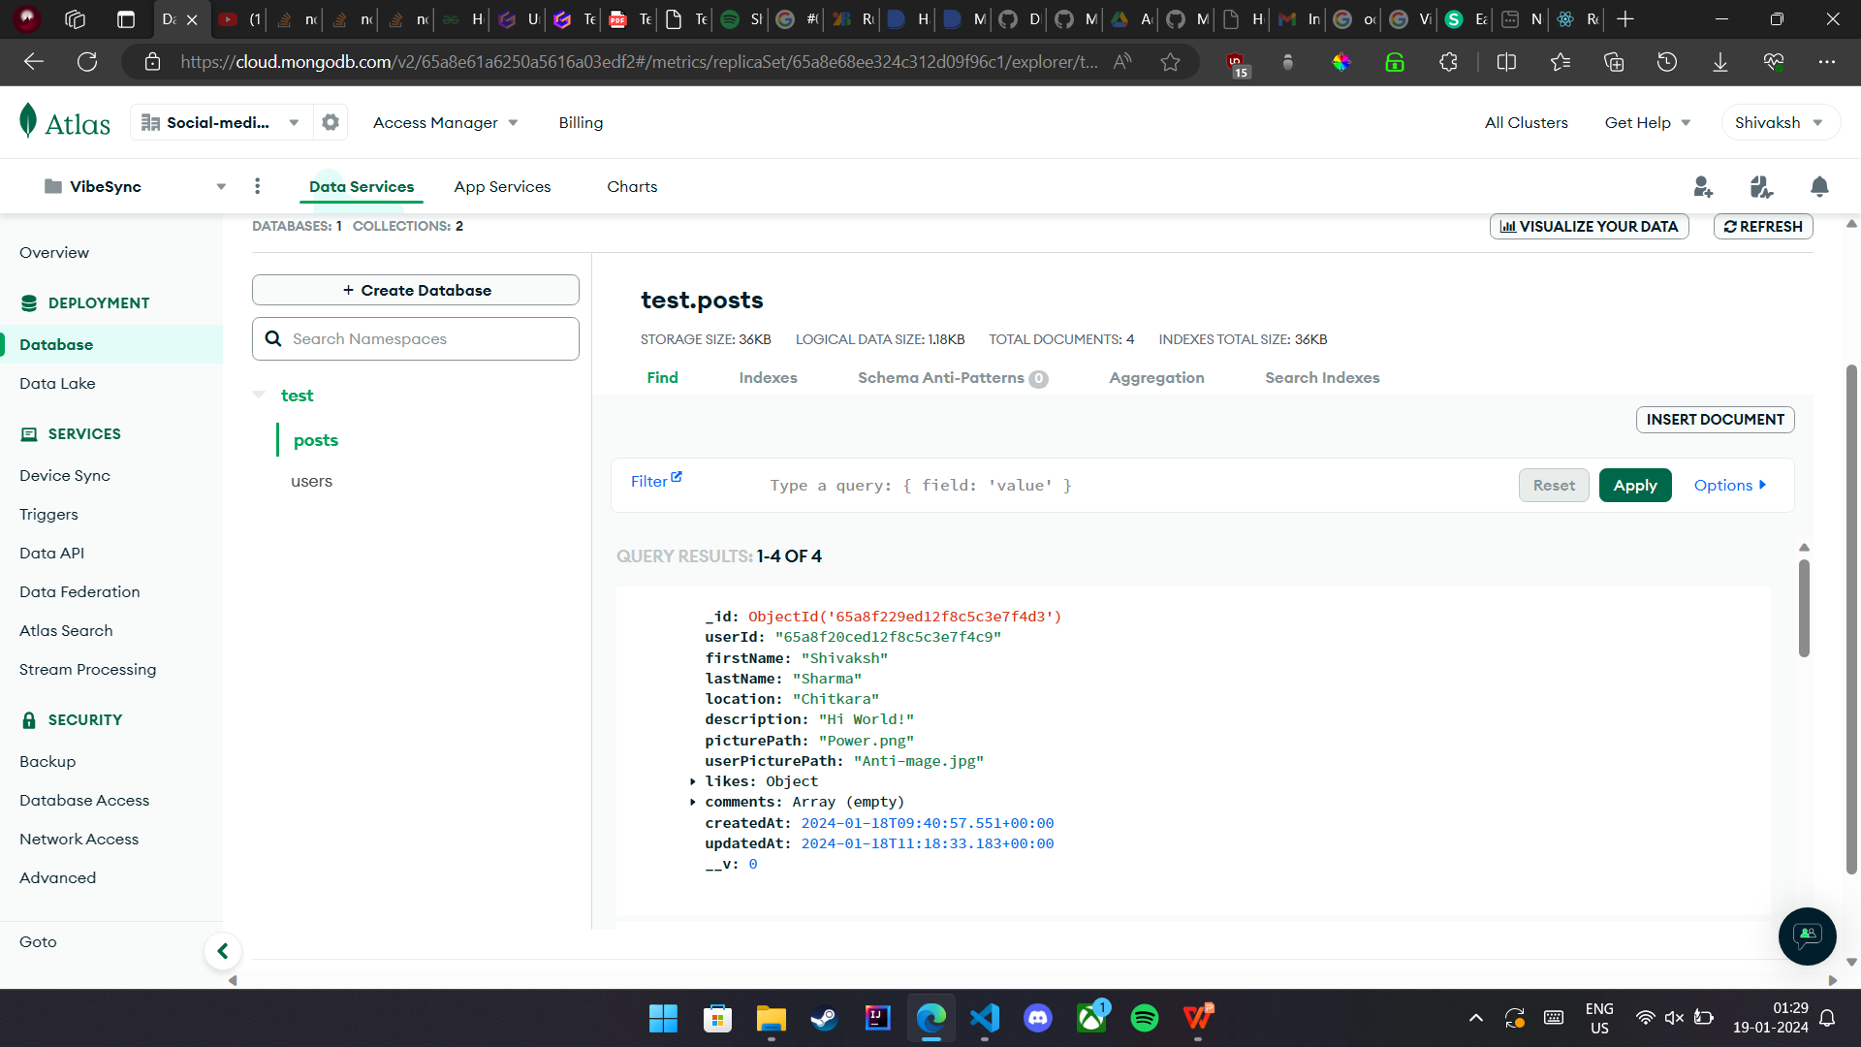

Slide 21
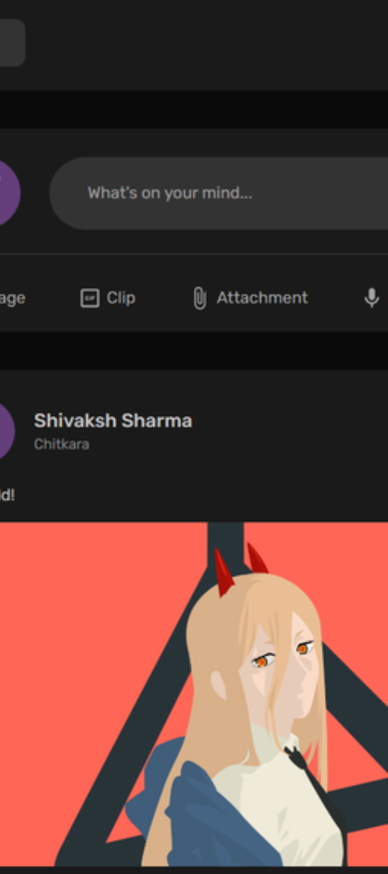
Future Updates and Improvements
1
Enhanced User Experience
2
Innovative Features
Continually evolve to enhance the overall user experience based on community feedback and emerging trends.
Introduce innovative features to keep the platform fresh, exciting, and in line with evolving user expectations.
3
Security Enhancements
Implement robust security measures to safeguard user privacy and ensure a secure and trustworthy environment.

Slide 22
Conclusion and next steps
1
Reflect and Learn
Reflect on the journey so far, learn from the experiences, and appreciate the progress made.
2
Feedback and Iteration
Seek feedback, iterate on the app's features, and continuously refine the VibeSync experience.
3
Exciting Roadmap Ahead
Look forward to an exciting roadmap ahead, filled with new developments and promising opportunities.

Slide 23
Thank You.

